Slide 1
Deep Biaffine Attention For Neural Dependency Parsing
Zhen Cheng

Slide 2
Outline
Motivation
Models
Features
Results

Slide 3
Motivation
Neural tools have shown a great deal of promise across domains, so it would be wise to see to what extent dependency parsing can benefit from them.
A parser that only uses general tools can benefit from innovations in those tools that come from other rapidly moving domains.
Advances in the realm of dependency parsing have a higher chance of impacting other fields when they all share the same tools.

Slide 4
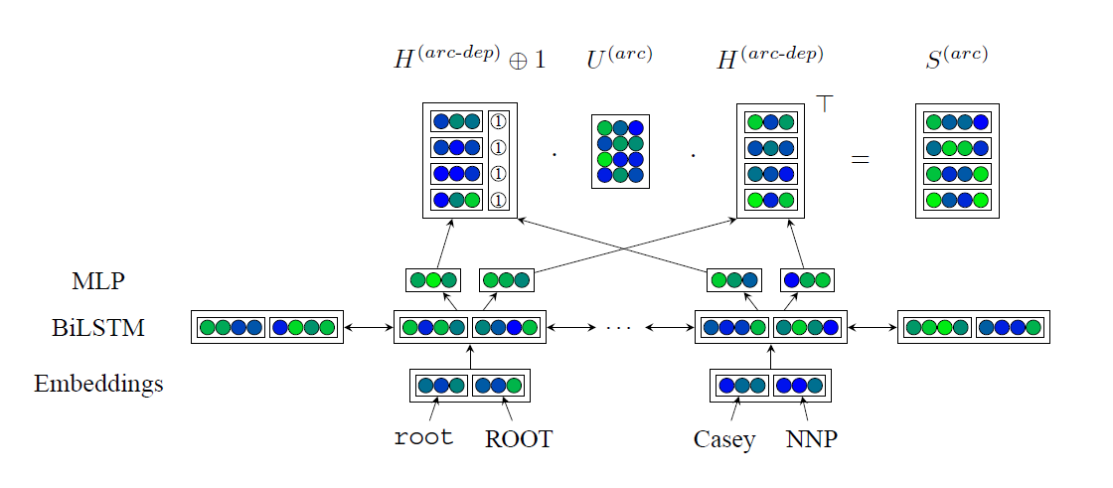
Models
Deep Biaffine Parsing
find head for each word
Deep Biaffine Classification
find label for each arc

Slide 5
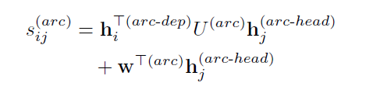


Features – Biaffine
Substitutes the concatenation-based attention mechanism they use with a variant of the bilinear attention proposed.
Biaffine attention mechanism.
source & target alignment => potential dependency => potential dependency arc as
arc as bilinear map biaffine map

Slide 6
Features – Biaffine
Why use biaffine instead of bilinear?
In dependency parsing, the distribution of dependents is similarly uneven—many words have a global tendency to attract dependents and others have a global tendency to deter them.
e.g. verbs frequently take many dependents
function words generally have no dependents
 | Memory | Time
Traditional attention | O(dn^2) | O(dn^2+cn)
BiLinear/BiAffine attention | O(dn+n^2) | O(dcn+cn^2)

Slide 7
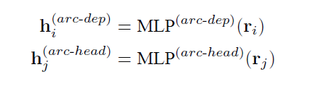
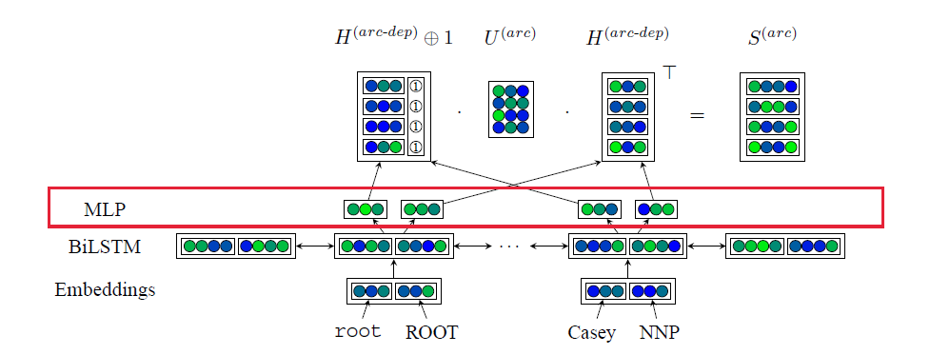
Features – MLP
Additional MLP layers and making it parallel to traditional classification

Slide 8
Features – MLP
Why add MLP layers?
Recurrent vectors contain too much information.
– overfitting
Recurrent vectors ri consists of the concatenation of the left recurrent state and the right recurrent state.
– actually distinct, ideally composed
MLP can combine the two recurrent states and reduce the dimensionality simultaneously.

Slide 9
Results – Experiment
Data set: Penn Treebank
Default:
100-dimensional word and tag embeddings with word vectors
15% chance of dropping tag embeddings
4-layer BiLSTMs with 300-dimensional left and right LSTMs
75% keep probability between timesteps
67% keep probability between layers
1-layer 100 dimensional MLP layer with the elu function and 67% keep probability
the Adam optimizer with β1 = β2 = 0.9

Slide 10
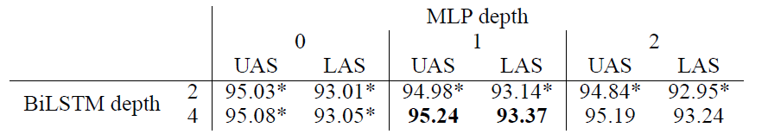
Results – using different hyperparameter
Depth
BiLSTM with more layers can learn more abstract features
Deep MLP will hinder performance
Consider the cost of training deep LSTM

Slide 11
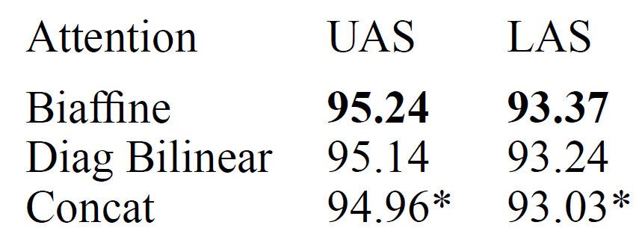
Results – using different hyperparameter
Attention mechanism
Biaffine – O(d^2) parameters
Bilinear – O(d) parameters
Concatenation – O(d) parameters

Slide 12

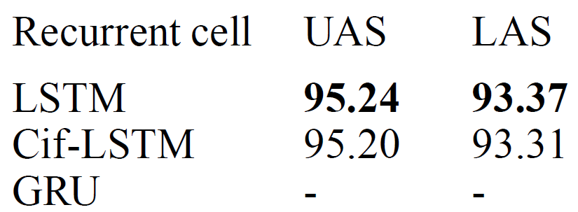
Results – using different hyperparameter
Recurrent cell
GRU cannot be trained with recurrent dropout – loss explosion
Modify the formulation of LSTMs to make them more GRU-like by using a coupled input-forget gate (CifLSTM)

Slide 13
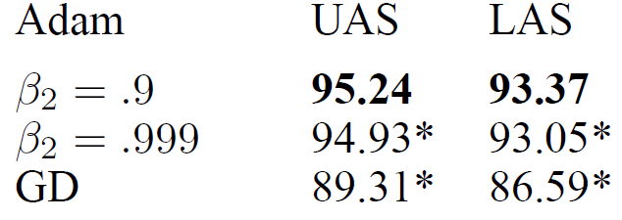
Results – using different hyperparameter
Optimization algorithm
Adam & Gradient Decrease
β2 is the decay rate for moving average

Slide 14
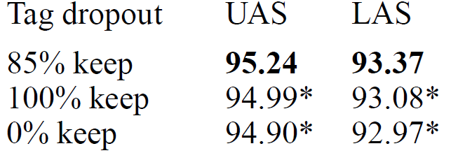
Results – using different hyperparameter
Tag dropout
Maybe overfit to specific sequences of POS tags
To keep our model from depending too heavily on POS tags

Slide 15
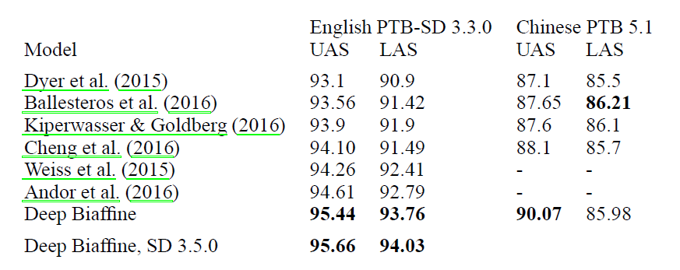
Results – compared with other models

